Slide 1
C39FF: Finance and Financial Reporting
Introduction to Accounting and Finance
Week 1, Semester 2
(2024/25)

Slide 2
Is accounting cool?
View of accountants as dull, straight-laced and stuffy
Survey
  28% of public perceive accountancy as a dynamic profession embracing new technologies, whilst 53% of accountants hold the same perception
  60% of accountants under 35 have a Facebook profile compared with a national average of 23%

Slide 3
Intro to accounting and finance?
Accounting
  Concerned with collecting, recording, analysing and communicating financial information
  Used by people making business decisions
Finance
  Concerned with the ways funds for a business are raised and invested
  Also used by people making business decisions

Slide 4
Main users of financial information relating to a business
Owners
Customers
Competitors
Employees
and their representatives
Managers
Business
Lenders
Government
Investment analysts
Community representatives
Suppliers

Slide 5
Qualities that influence usefulness of Accounting information
Relevance
  Confirmatory e.g. establishing last year’s profit
  Predictive e.g. predicting next year’s profit
  Materiality – information that is significant for decision making
Reliability
  Completeness – provide all the information needed to understand what is being portrayed
  Neutrality – information presented and selected without bias
  free from error – faithful representation

Slide 6
Qualities that influence usefulness of Accounting information
Comparability
  Standardisation; comparisons
Verifiability
  Subjective judgement, evidence
Timeliness
    Up to date information, in time for decision making
Understandability
    For non-accountants; as clear as possible (myth or reality?)
Cost constraint
    Benefits of information must outweigh cost of producing it

Slide 7
The qualities that influence the usefulness of accounting information
COST CONSTRAINT
Qualities
Fundamental
Enhancing
Relevance
Faithful representation
Predictive value
Confirmatory value
Completeness
Neutrality
Freedom from error
Materiality threshold
Comparability
Timeliness
Verifiability
Understand-ability

Slide 8
Types of Accounting
Management Accounting
Internal use (decision making for managers), cost analysis (in year)
Financial Reporting
External reporting, communicating company information for decision-making (year-end)
Auditing
External validation of financial statements (post year-end)
Taxation
Tax computation and avoidance (post year-end)

Slide 9
Management & Financial Accounting
Management Accounting
  Internal info; addresses the need of the business
Financial Accounting
  External info: addresses the needs of others
Differ in terms of
  Reports produced
  Level of reporting detail
  Time orientation
  Regulation requirements
  Information range and quality

Slide 10
Management and financial accounting compared
Management accounting
Financial accounting
Nature of the
reports produced
Tend to be specific purpose
Tend to be general purpose
Level of detail
Often very detailed
Usually broad overview
Regulations
Unregulated
Subject to accounting regulation
Reporting
interval
As short as required
by managers
Usually annual or bi-annual
Uses projected future information as well as past information
Time horizon
Almost always historical
Range and quality
of information
Contains financial and non-financial information. Uses information that cannot be verified
Focus on financial information. Emphasis on objective, verifiable
evidence

Slide 11
Financial Reporting
Assets
=
Liabilities
+
Equity
Company Pension
Pension Assets
Financial Instruments
Value?
Pension Obligations
Defined Benefits
Value?

Slide 12
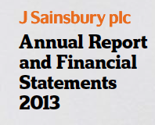
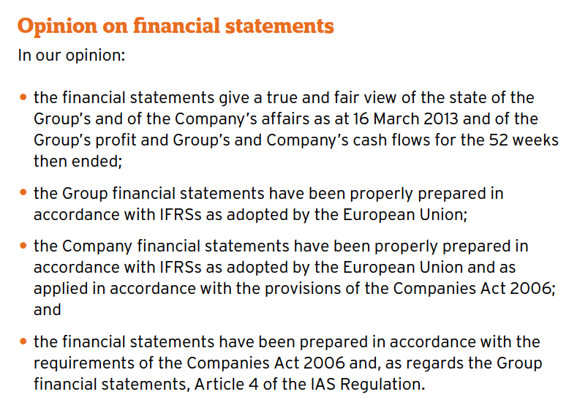
Auditing

Slide 13

Annual Report

Slide 14
Why Study Accounting?
Accountants provide information, but managers make decisions
Understanding financial information will make you better managers
  How accounting reports should be read and interpreted
  How financial plans are made
  How investment decisions are made
  How businesses are financed

Slide 15
Maximisation of Owners’ wealth
Key business objective
Long-term concept, not always ‘get rich quick’
Balance this with needs of other stakeholders
  Human rights
  Working conditions
  Sustainability
  Mission statement

Slide 16
Costs – is it just about money??
Nike and Gap
  Improving work, pay and conditions of staff in Asia
    Initial higher costs
    Enhanced corporate reputation
    Happier employees
    Social responsibility!

Slide 17
Risk v Return (reward)
Investors require some return to induce them to invest money in a business
The higher the risk the higher the required return
Return
Risk

Slide 18
Accounting rules & regulations
Companies are owned by shareholders but managed by directors
Most shareholders of large companies are not involved in the daily operations
Shareholders rely on financial reports for information to make important decisions
Stakeholders rely on financial reports for information to make important decisions
Regulations attempt to ensure financial reports provide a true and fair view

Slide 19
Enron
Enron grew from small beginnings to become the 7th largest company in the US. It employed more than 21,000 staff in more than 40 countries.
The success was not all it seemed. Deception was prolific regarding profits, hidden debts and losses hidden in intricate deals.
Investors and creditors forced the company into bankruptcy in 2001.
Enron changed the business world and the accounting profession.
Thousands of employees lost their jobs; pension rights were lost; investors lost $billions

Slide 20
The accountants involved in Enron
The company directors and managers devised various fraudulent schemes.
  Several are now in prison.
One Enron employee became a ‘whistle blower’ and lead investigators into the trail of the crooked practices.

Slide 21
The accountants involved in Enron
Enron’s auditor, Arthur Anderson was one of the ‘big 5’ firms of accountants in the world at the time and prided themselves as the number 1 firm.
  They were found guilty of deliberately destroying evidence of its relationship with Enron (shredded the relevant files).
  AA collapsed.
  The accounting profession came under huge public scrutiny as a result.

Slide 22
Rules and Regulations
Companies Act
Accounting Standards – International and National
Best practice and Generally Accepted Accounting Principles (GAAP)
Commercial laws
EU directives
Stock Exchange requirements
…the list goes on…and on….and on…

Slide 23
Purpose of the Regulations
True and Fair view
Requirement to produce accounting information in an approved format and timescale
Do regulations guarantee anything?
Do regulations cause their own problems?

Slide 24
Sources of Accounting Rules
Corporate Governance
International Accounting Standards Board
  International Financial Reporting Standards
  International Accounting Standards
Company law
  Disclosure of directors’ remuneration
  Disclosure of auditors’ fees
Financial Conduct Authority
  Compliance with UK Corporate Governance Code
  UK Corporate Governance Code sets out standards of good practice in relation to board leadership and effectiveness, remuneration, accountability and relations with shareholders.

Slide 25
Summary
Accounting is concerned with collecting, analysing and communicating information.
Accounting information may be used to make internal decisions or provide external information
Regulations and rules surround the way accounting information is presented
Fundamental concepts underpin accounting information
Stakeholders may be interested in the accounts

